Slide 1
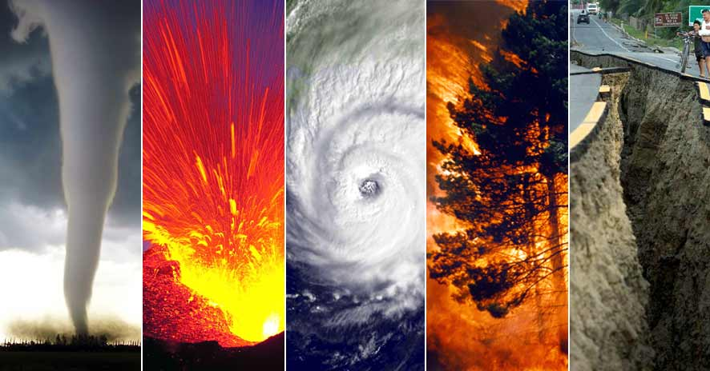
Project Cymopolea:
Natural Disaster detection from tweets
Author: Terence Yep
Image source: www.alrasub.com

Slide 2
Introduction
On average, approximately 60,000 people globally died from natural disasters each year
Low frequency, high impact events such as earthquakes cause significant but preventable loss of human life

Slide 3
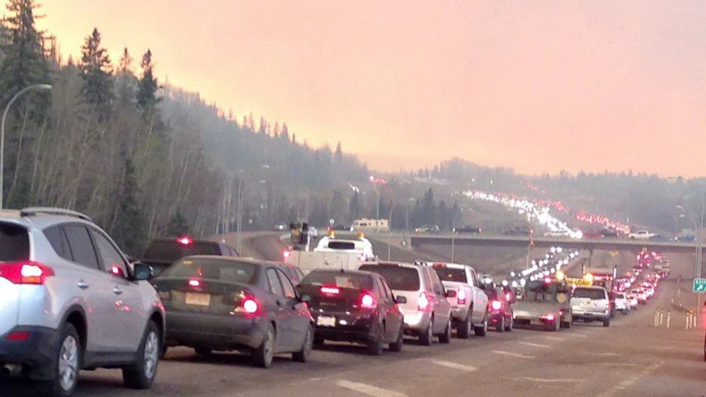
Why Bother?
Total $210 billion dollars in losses world-wide in 2020
Up 26% since 2019
Preventable loss of human life
Last year’s natural disasters claimed approximately 8,200 lives
Fraudulent insurance claims
Why Twitter?
real-time microblogging platform
186 million daily active users as of 2020
150 million users worldwide, 36 million from US

Slide 4
Objectives
Detect natural disaster tweets
Detect natural disaster images from attached images

Slide 5
Data sources and Methodology part 1
Business case
Real-time information currently lacking/under-serviced
Gather data
Pre-labeled tweet dataset from Kaggle
Pre-labeled images dataset from Kaggle
Generate dataframe
Notes:
Don’t be library focused
Focus on processes
Preprocessing steps
Generating dataframe/
Exploration (on separate slide because significant amount of work was done here)
Separate slide for wordcloud and eda
Talk about storm flood, fires

Slide 6
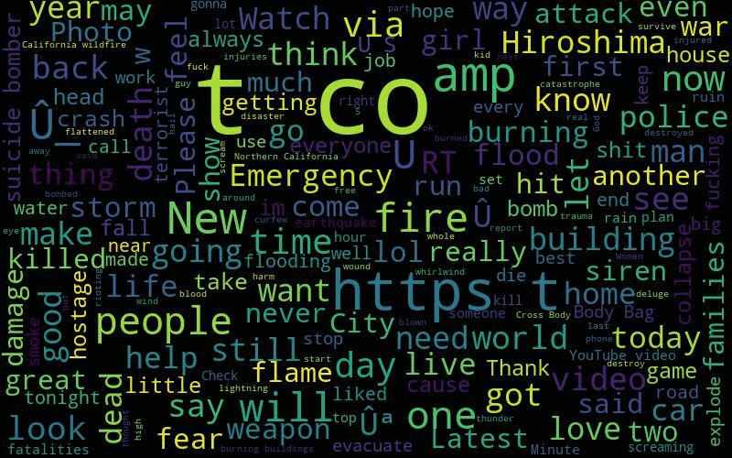
Data sources and Methodology part 2
Preprocess data
Removed symbols, hyperlinks, punctuations, stop words using custom regex patterns
Lemmatized words
Changed target labels for tweets using non-natural disasters words
Tweet sentiment
Visualization
Barplots (count-based features)
wordcloud
Modeling
Logistic Regression
Ensemble (RandomForest, GradientBoost)
Model optimization : Random search Cross validation

Slide 7
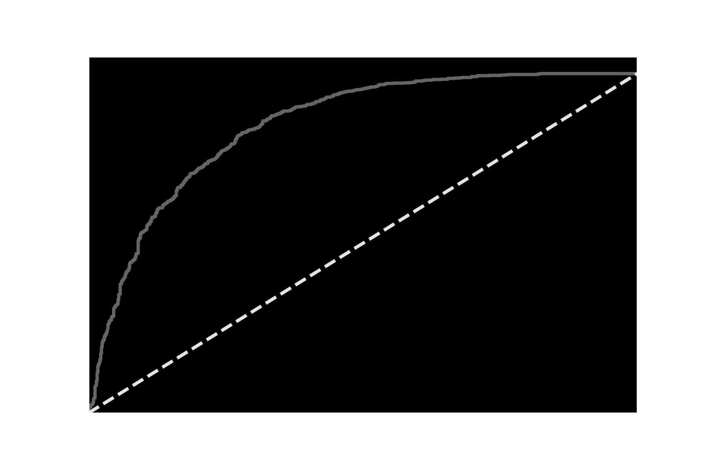
Results
Best model based on accuracy
RandomForest classifier
~78% accuracy with an FPR ~6.47%
AUC ~0.85
Specificity of 94%
Sensitivity of 55%
Worst model
Unigram BoW with Gradient-Boost classifier
~65%
AUC ~0.85

Slide 8
Limitations
Class imbalance
More non-disaster vs disaster tweets
Responsible for skew in sensitivity and specificity
Bias introduced during pre-processing
Suicide, war were excluded
Locations and keywords were excluded

Slide 9
Future Directions
Include location and hashtags/keywords in modeling
Improve accuracy of model (95% target)
Word embeddings and deep learning (LSTM)
Mobile app that tracks and sends email to subscriber

Slide 10
Fin

